Slide 1

Scaffold and AppBar
Explain what UI elements of an app are defined in the Scaffold
Define an AppBar in your app
Center and format its title
Define action buttons in the AppBar
Define and style a FloatingActionButton (fab) in your app
Define a BottomNavigationBar in your app

Slide 2
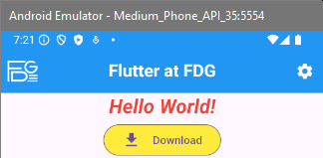

Next Goal: show an AppBar on top of our app
From last lesson (Column without MainAxisAlignment.center):
Added an AppBar on top of the App

Slide 3
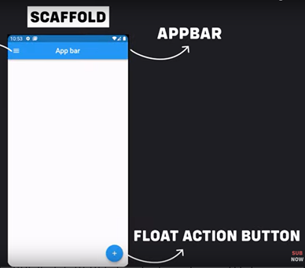
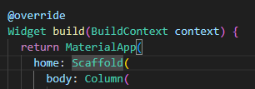
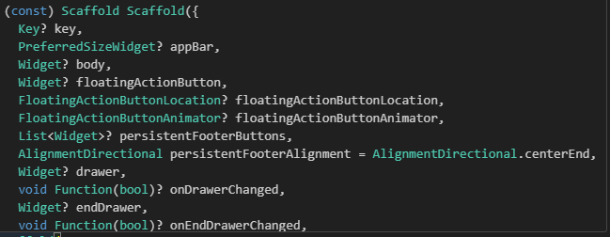
Children of the Scaffold (deutsch: Gerüst)
Copied from https://www.youtube.com/watch?app=desktop&v=D4nhaszNW4o at 3:34

Slide 4
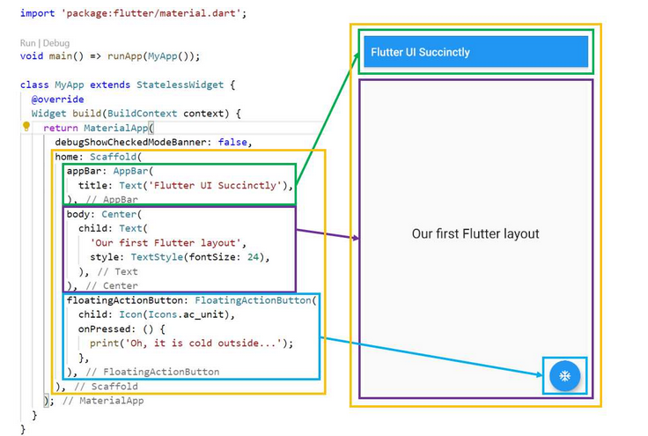
Scaffold’s c-tor arguments
Copied from https://antonioleiva.com/flutter-mobile-development-for-busy-people-droidkast-05/
Notes:
Succinctly -> kurz und bündig
ac_unit -> air conditioner unit

Slide 5
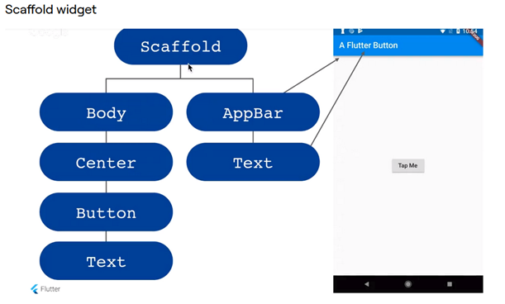
The widget tree below Scaffold
Copied from https://antonioleiva.com/flutter-mobile-development-for-busy-people-droidkast-05/

Slide 6
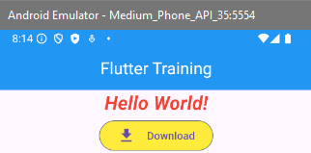
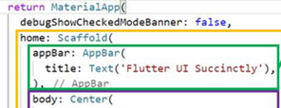
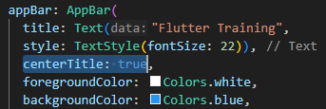
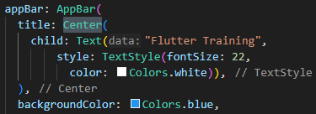
Exercise
Create the following AppBar for our HelloWorld App:
Reminder from one of the last slides:
Hint: You can use properties of class AppBar to show the title in the center and in white. But there are also other ways to achieve this.
Solutions:
or
Notes:
Hier auch nochmal auf debugShowCheckedModeBanner hinweisen !

Slide 7
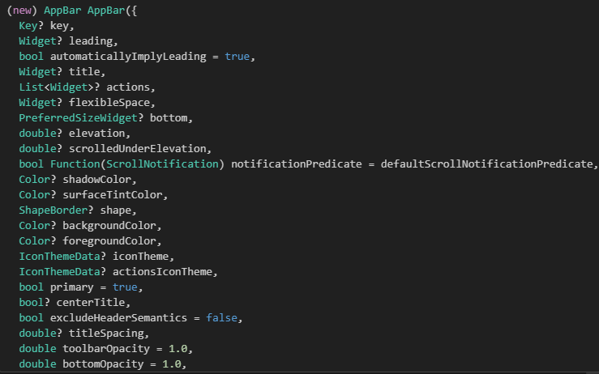
More c-tor arguments for an AppBar

Slide 8
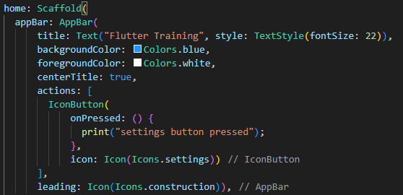
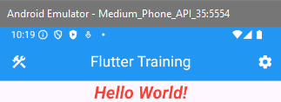
leading and actions
Exercise:
Implement the same or something similar by your own. Try to define 2 children in the list behind “actions:”
Notes:
appBar: AppBar(
title: Text("Flutter Training", style: TextStyle(fontSize: 22)),
backgroundColor: Colors.blue,
foregroundColor: Colors.white,
centerTitle: true,
actions: [
IconButton(
onPressed: () {
print("settings button pressed");
},
icon: Icon(Icons.settings))
],
leading: Icon(Icons.construction)),

Slide 9
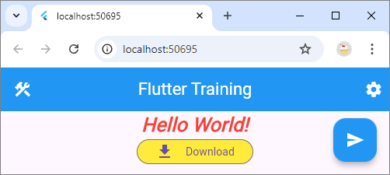
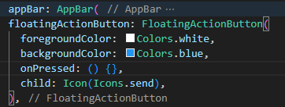
Define a Floating Action Button
Exercise:
Define a FloatingActionButton in your app and test it on Chrome or Edge. Observe what happens when you resize the browser window.
Define and test the properties “splashColor” and “hoverColor” of a FloatingActionButton. Finally use the property “mini” of a fab (short for FloatingActionButton)
Notes:
floatingActionButton: FloatingActionButton(
mini: true,
foregroundColor: Colors.white,
backgroundColor: Colors.blue,
hoverColor: Colors.red,
splashColor: Colors.green,
onPressed: () {},
child: Icon(Icons.send),
),

Slide 10
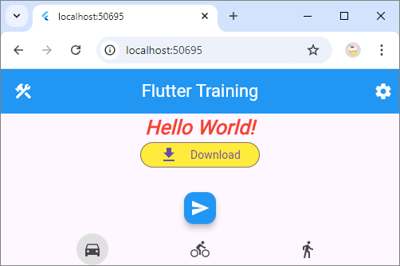
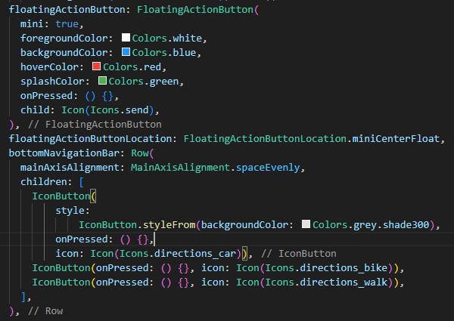
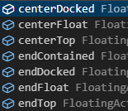
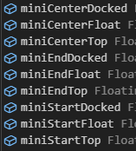

FloatingActionButtonLocation and BottomNavigationBar
Notes:
floatingActionButtonLocation: FloatingActionButtonLocation.centerFloat,
bottomNavigationBar: Row(
mainAxisAlignment: MainAxisAlignment.spaceEvenly,
children: [
IconButton(
style:
IconButton.styleFrom(backgroundColor: Colors.grey.shade300),
onPressed: () {},
icon: Icon(Icons.directions_car)),
IconButton(onPressed: () {}, icon: Icon(Icons.directions_bike)),
IconButton(onPressed: () {}, icon: Icon(Icons.directions_walk)),
],
),

Slide 11
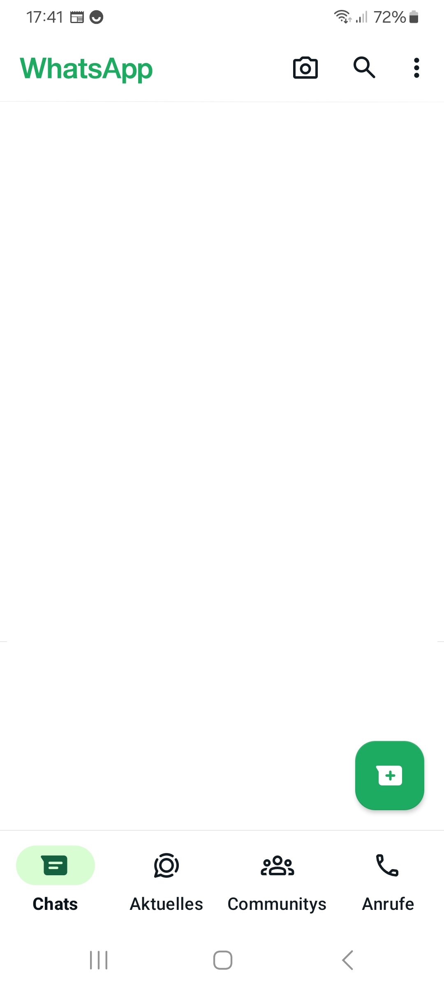
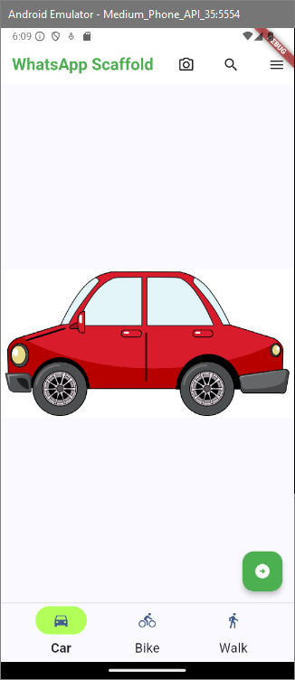
Possible goal in the next weeks
Define a Scaffold that looks like WhatsApp:
Notes:
Column(
mainAxisSize: MainAxisSize.min,
children: [
OutlinedButton(
style: OutlinedButton.styleFrom(
backgroundColor: Colors.lightGreenAccent.shade200,
side: const BorderSide(color: Colors.transparent)),
onPressed: () {
}
,
child: const Icon(Icons.directions_bike)),
Text("Bike",
style: TextStyle(
fontWeight: FontWeight.bold
))
],
),

